Slide 1
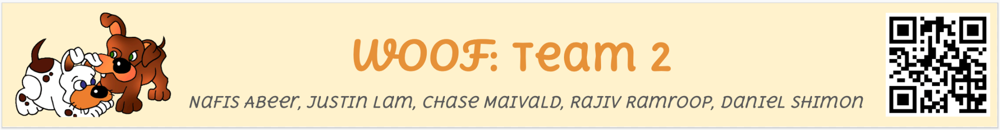
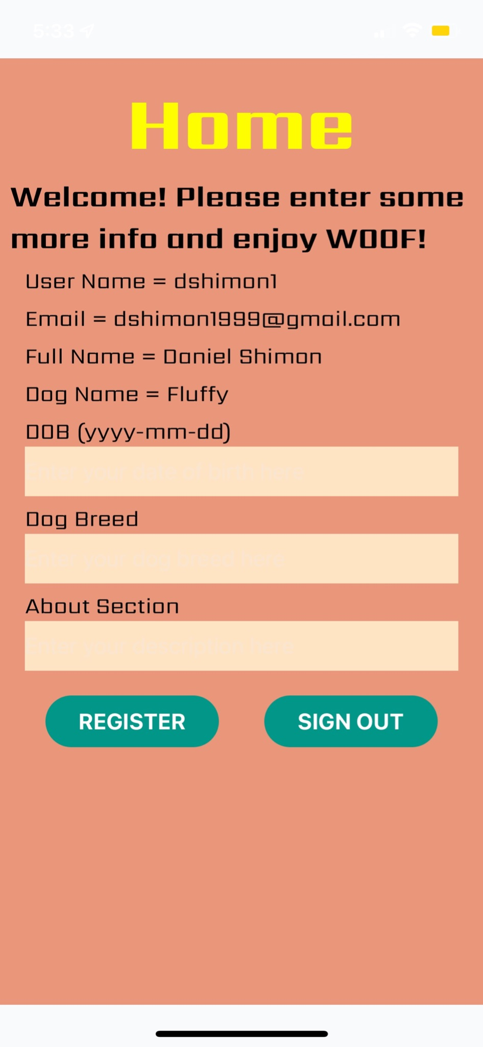
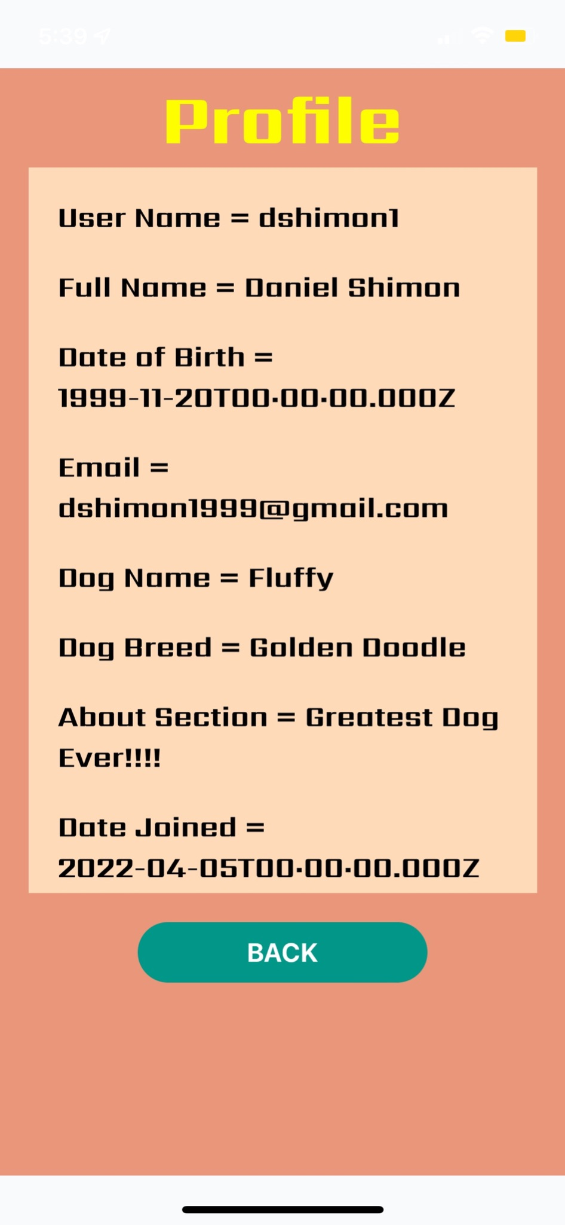
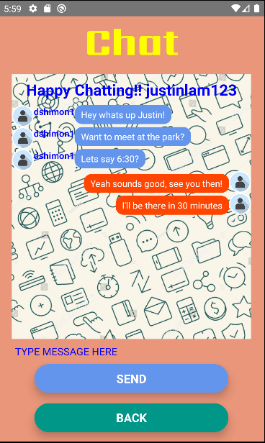
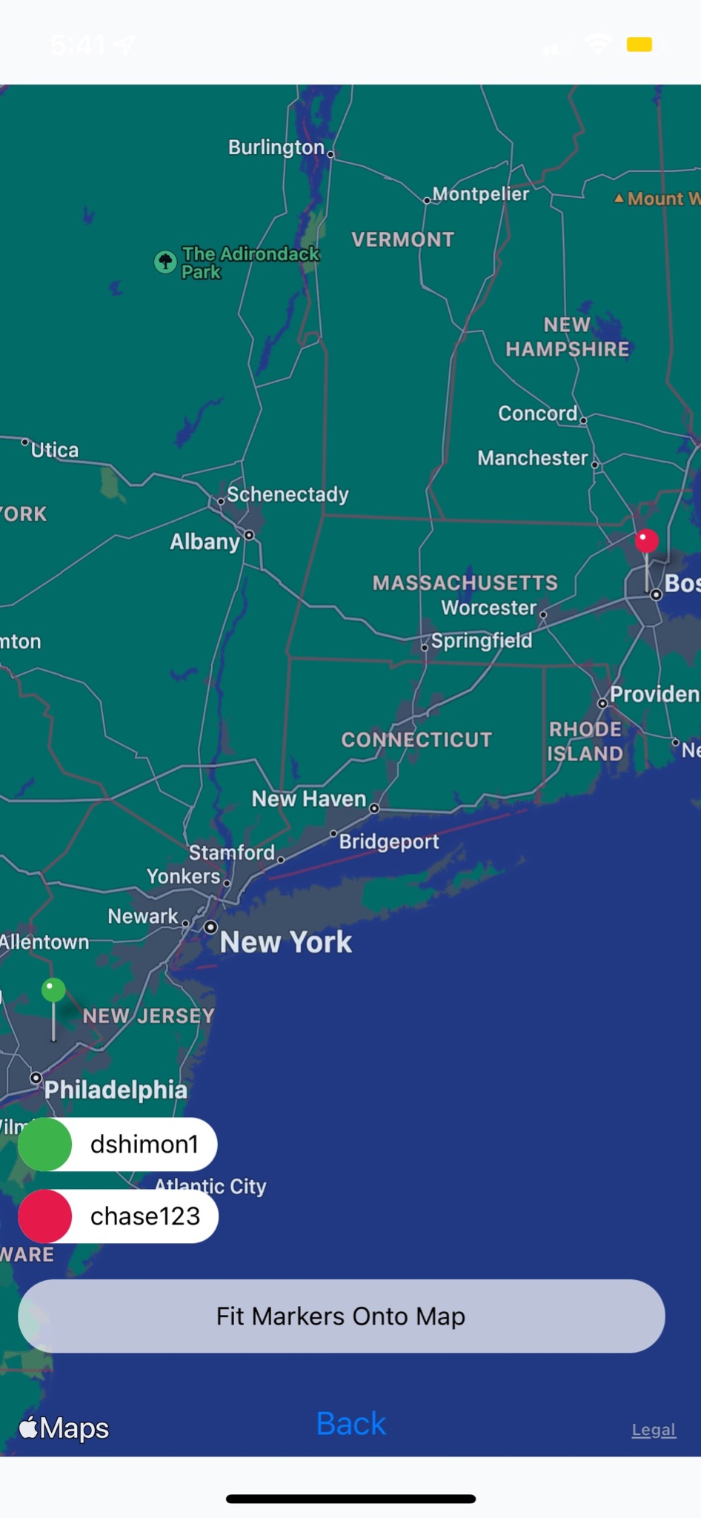
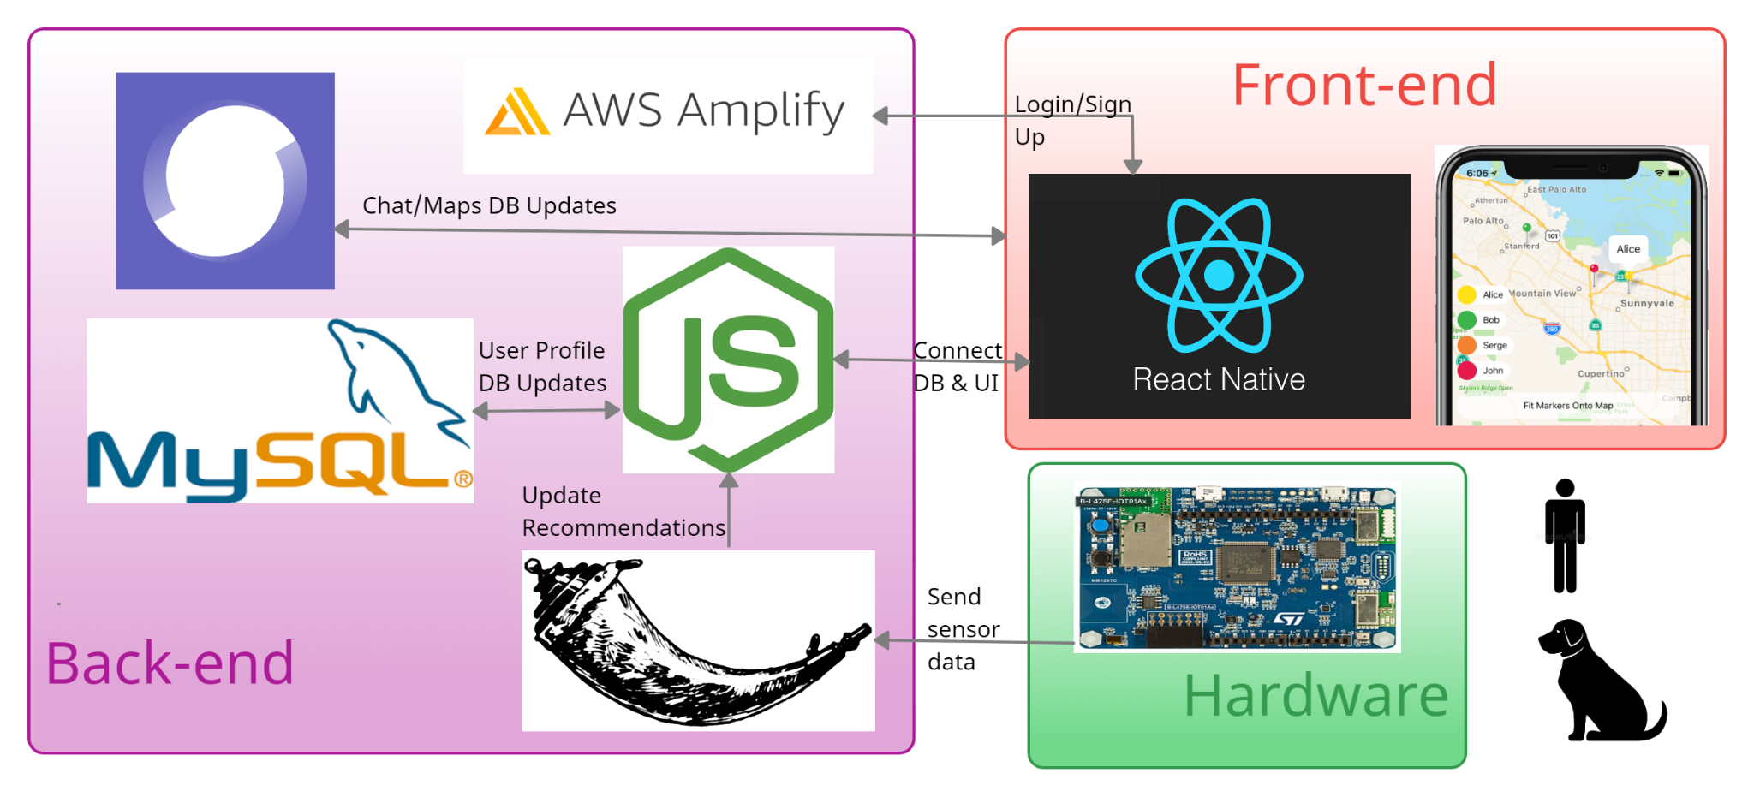
background
Target audience is dog owners
And their dogs
Social media application
Recommendations based on friendly interactions partaken by dogs
Dogs get to maintain persistent friendships as their owners can befriend their friends’ owners
Notable Results
User Authentication
End to End Connectivity
Capture Audio + Track Location
ML Model to Analyze Audio + Send to Database
Send to Database
UI Fetches Data from Database
User Interface
Add Friends Functionality
Maps - Friends Location Tracking
Chat with Friends
Room for Improvements
System Overview
Need to improve table organization of database to be more scalable
Need to increase accuracy of recommender system
Also need more classes
Need to collect more data
Profile page to improve pictures of users

